Slide 2
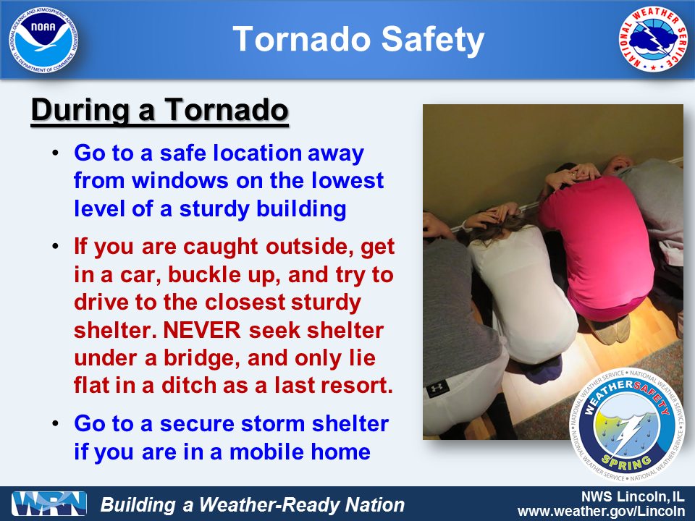
Tornadoes

Slide 3
Objectives
Lightning
Electric charge separation
Stroke development, types
Thunderstorms
Air mass and severe t-storms
Tornados
Fujita scale, geographic distribution
Supercell storms, tornado genesis
Today, Tuesday

Slide 4
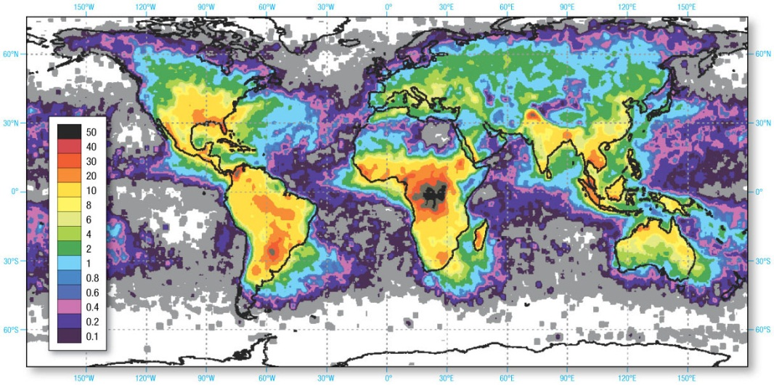
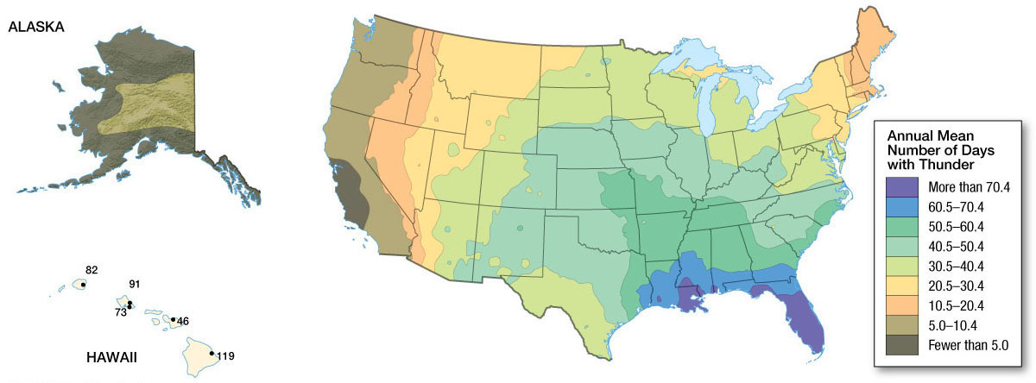
Distribution of Thunderstorms
Approximately 14.5 million thunderstorms occur each year across the globe.
Colors show lightning flashes per square kilometer and year

Slide 5
Introduction and terms
About 40,000 Thunderstorms Daily
Each produces lightning, about 20,000 Ampere per stroke
On AVERAGE 2,000 Ampere worldwide from Earth’s fair weather electric circuit
A few may produce tornadoes
Lightning types
80% of lightning occurs when clouds discharge electricity. This is referred to as cloud-to-cloud lightning, which occurs when voltage gradient overcomes the electrical resistance of the air.
The flash of cloud-to-cloud lightning is often obscured by the cloud so it is commonly called sheet lightning.
20% of lightning occurs when electrical discharge travels between the base of the cloud and the surface. This is referred to as cloud-to-ground lightning.

Slide 6
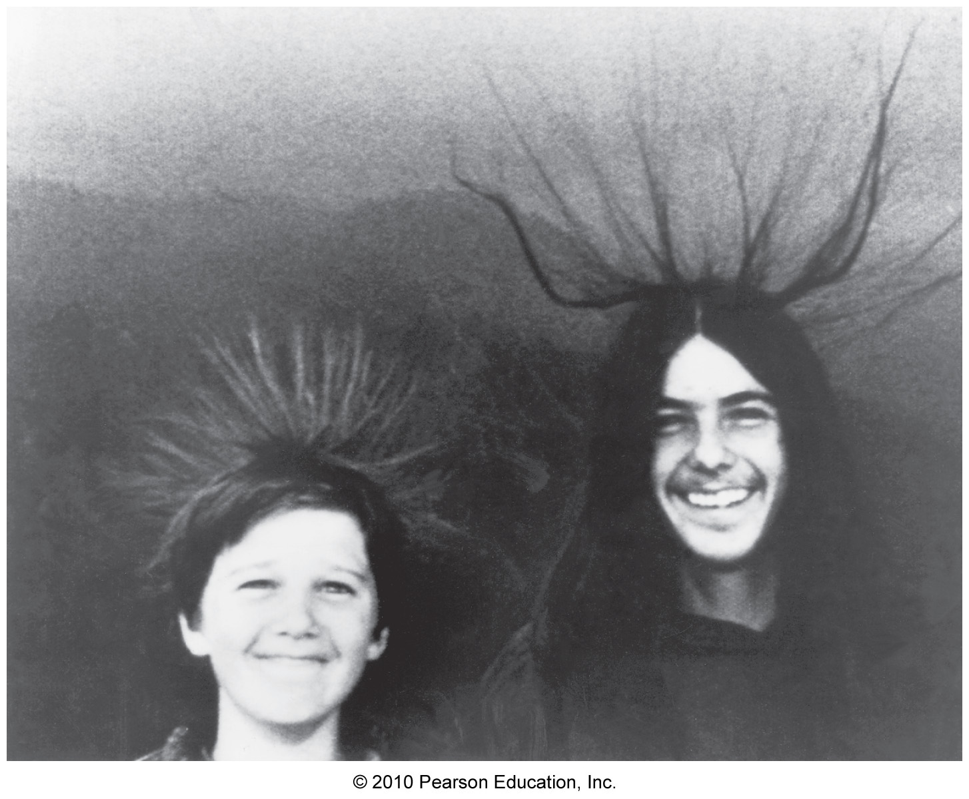
Processes of Lightning Formation
Electric charge separation causes strong electric field.

Slide 7
Processes of Lightning Formation
Charge Separation
All lightning requires a separation of positive and negative charges into different regions of the cloud.
Typically, positive charges accumulate at the top of a cloud, and negative charges in the lower part of a cloud.
Ice crystals in clouds influence charge separation.

Slide 8
Processes of Lightning Formation
Runaway Discharges
Lightning is different from a static electric spark
Instead, it is a consequence of electrons accelerated to high speeds
Collisions cause an avalanche of ”runaway” electrons
Runaway Breakdown
Energy is released when electrons accumulate in a small volume

Slide 9
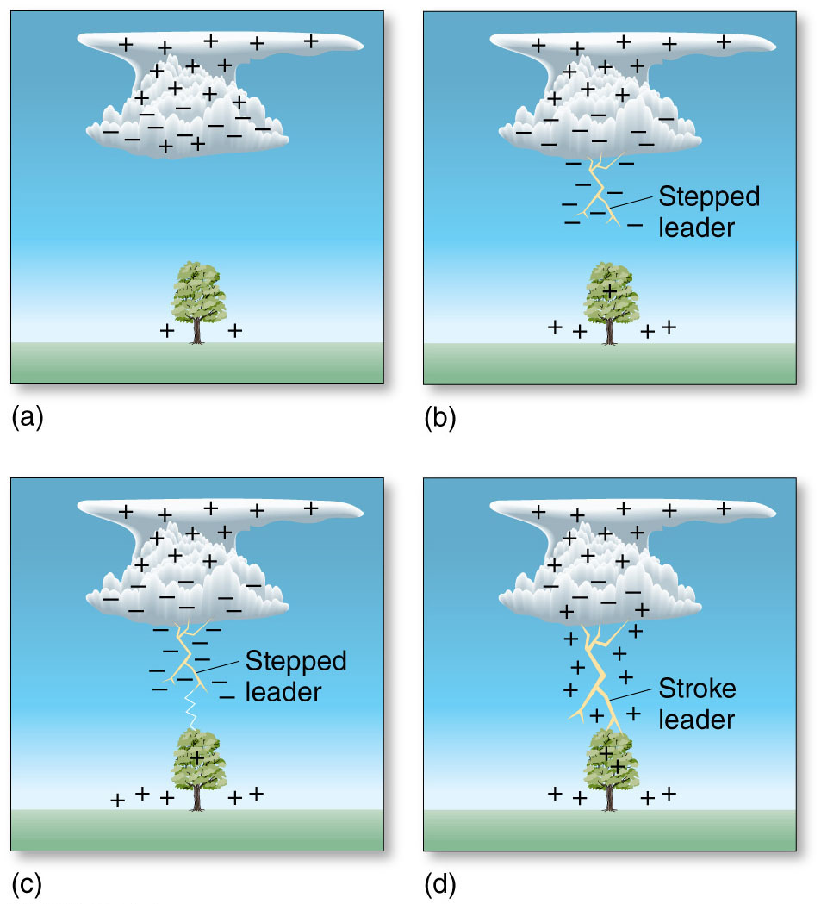
Processes of Lightning Formation
Charge Separation

Slide 10
Processes of Lightning Formation
Leaders, Strokes, and Flashes
The rapid and staggered advance of a shaft of negatively charged air is called a stepped leader.
As the leader approaches the ground a spark is created. When the leader and the spark connect a flow of electrons illuminates the cloud by strokes, or return strokes.
Not all of the first stroke neutralizes the negatively charged ions and results in another leader, the dart leader, in 1/10 of a second.
The combination of strokes is called a lightning flash.

Slide 11
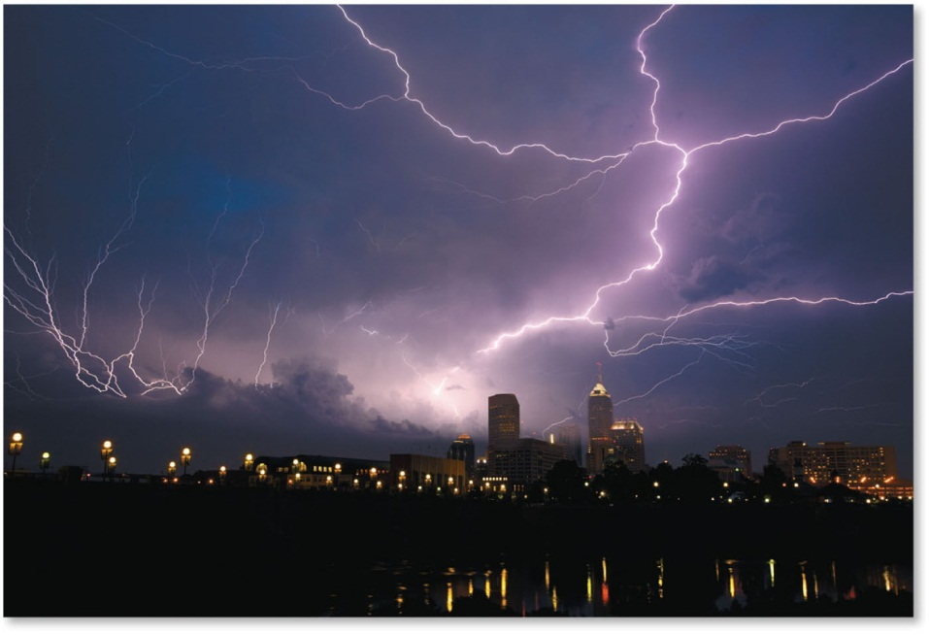
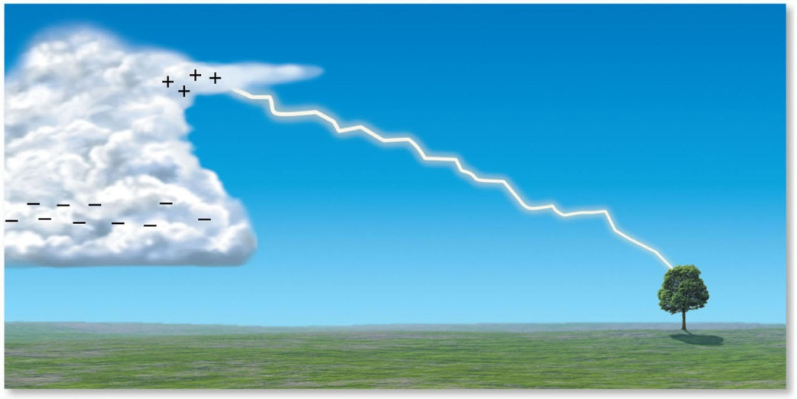
Processes of Lightning Formation
Leaders, Strokes, and Flashes
Positive stroke, much stronger than “usual” strokes
The flash refers to the entire process of transferring electrons from the cloud to the ground.

Slide 12
Processes of Lightning Formation
Types of Lightning
Ball lightning is less common than strokes and leaders and refers to the type of lightning that appears as round glowing mass of electrified air.
Small soil particulates bounce in the air as a result of chemical energy.
St. Elmo’s fire occurs when ionization in the air causes tall objects to glow as they emit sparks.
Sprites are very large electrical bursts that rise from cloud tops as lightning occurs below.
Blue jets are upward-moving electrical ejections from the tops of the most active regions of thunderstorms.

Slide 13
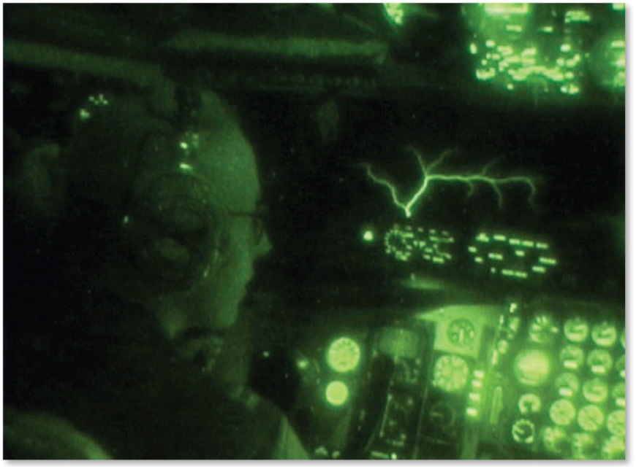
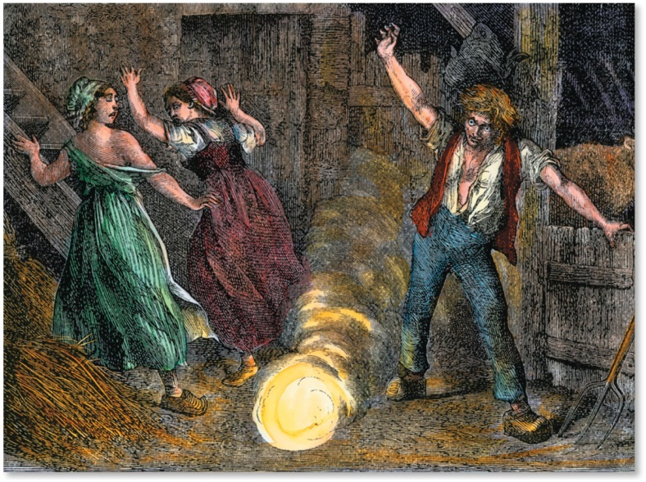
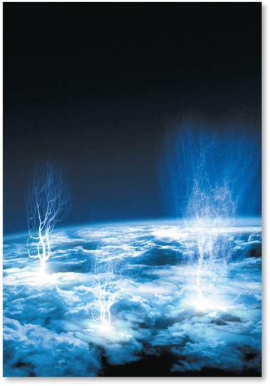
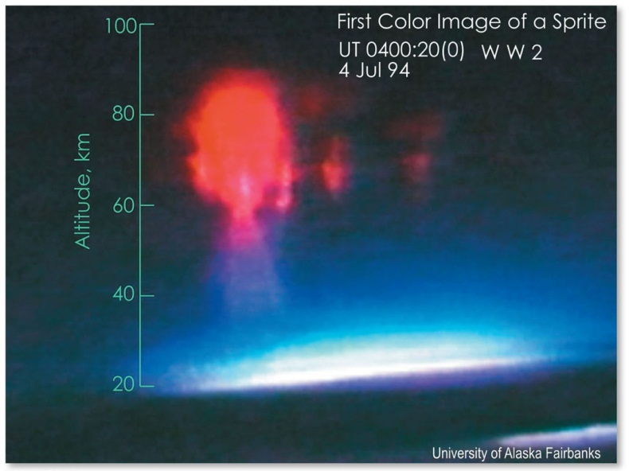
Processes of Lightning Formation
Types of Lightning

Slide 14
Processes of Lightning Formation
Thunder
Air expands explosively due to an increase in temperature during a lightning stroke and causes thunder.
A lag in lightning strike and thunder occurs due to sound traveling slower than light. 3s = 1km; 5s = 1mile
Lightning that seems to occur without thunder is referred to as heat lightning, though this term is misleading – it’s just lightning that’s too far away that it can be heard
When thunder is farther away, the echoing of sound waves off of objects (like buildings and hills) causes thunder to sound rumbling.

Slide 15
Lightning Safety
About 70 people each year are killed by lightning in the United States.
Practice the following when lightning is present:
Always take cover in a building.
Do not stand under a tree or other tall object that might serve as a lightning rod.
Avoid standing on rooftops, hills, or other high areas.
Do not watch lightning storms from a pool, lake, or hot tub.
So, just use common sense.

Slide 16
Thunderstorms: Air Mass, Multicell, and Supercell
Air Mass Thunderstorms – the “good” guys
Air mass thunderstorms are relatively small, localized, short-lived thunderstorms that do not produce strong winds, large hail, or tornados.
They are the most common and least destructive thunderstorms.
Air mass thunderstorms consist of several updrafts, each following a sequence of stages:
Cumulus stage: uplift begins and clouds form.
Mature stage: precipitation begins to fall.
Dissipative stage: precipitation diminishes and the sky begins to clear.

Slide 17
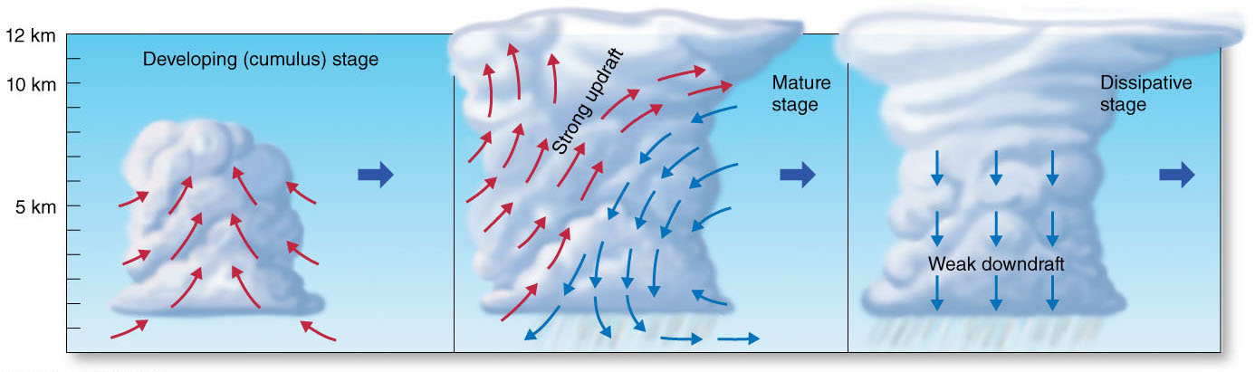
Thunderstorms: Air Mass, Multicell, and Supercell
Air Mass Thunderstorms
5-20 m/s updraft
T drops with SALR
Bergeron process
Precipitation starts to fall
Rain or hail in area of heaviest precipitation exert drag -> downdrafts
Precip. partly evaporates
->cooling of air, T drops
by 10ºC at surface
If all of the cloud
has heavy precip.
-> downdrafts everywhere
-> suppresses resupply
of water vapor from surface. Along with the colder surface T and the cloud itself evaporating the T-storm dissipates

Slide 18
Thunderstorms: Air Mass, Multicell, and Supercell
Multicell and Supercell Storms – the “bad guys”
Thunderstorms can develop into clusters known as multicell thunderstorms.
Organized groups of thunderstorms are referred to as mesoscale convective systems (MCSs).
Two types of MCSs occur:
Mesoscale convective complexes (MCCs): circular clusters
Squall lines: linear bands of thunderstorms.
These storms cells (thunderstorm clusters) develop from a common origin or exist because some cells directly lead to the formation of others.
Severe T-storm: Winds exceed 58 mph, have large hailstones (0.75in) or produce tornadoes.

Slide 19
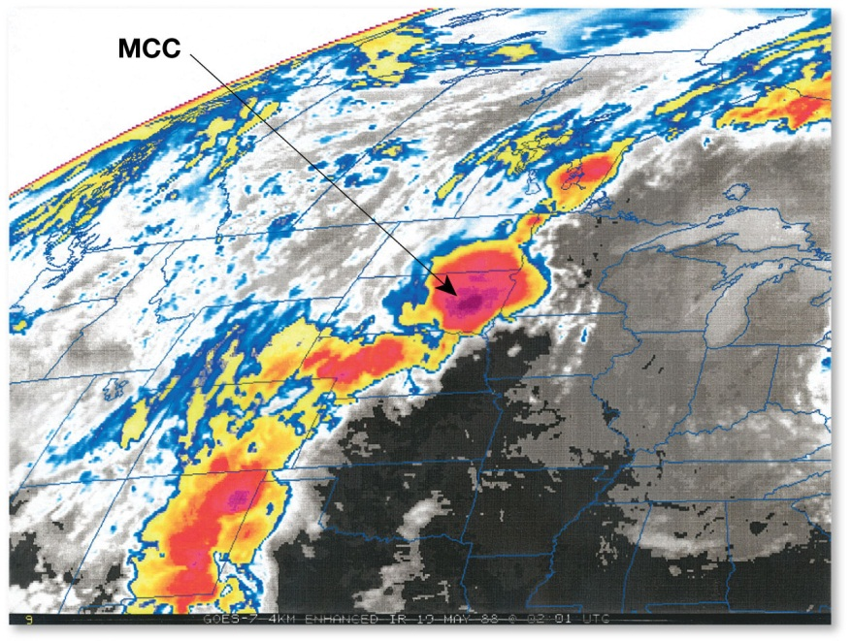
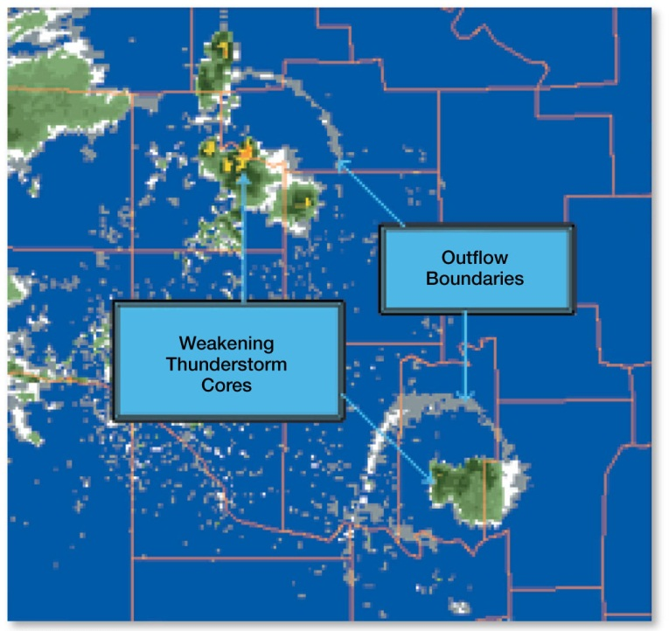
Thunderstorms: Air Mass, Multicell, and Supercell
Multicell and Supercell Storms
MCCs are a circular cluster of thunderstorms. These clusters help to create more thunderstorms.
The downdraft spreads outward and converges with the warmer surrounding air to form an outflow boundary.

Slide 20
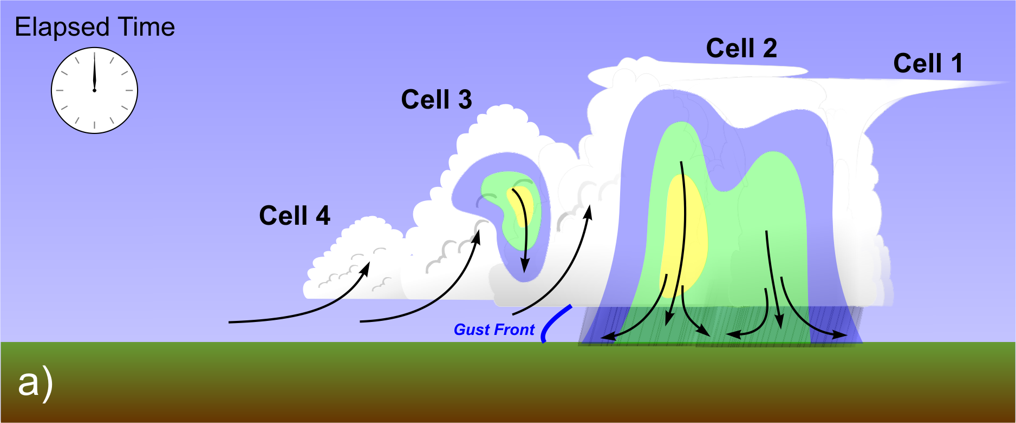
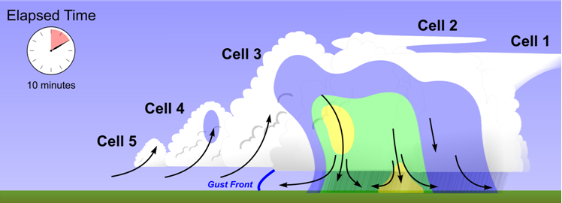
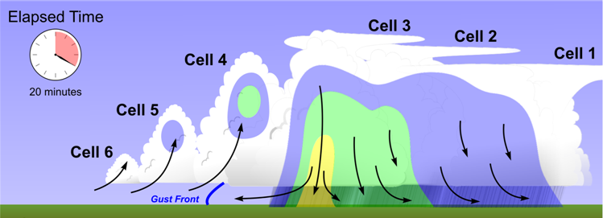
Thunderstorms: Air Mass, Multicell, and Supercell
Colder, dense air, pushes warmer & moist & lighter air upward, forced convection by cell 2 -> new cell 3 develops

Slide 21
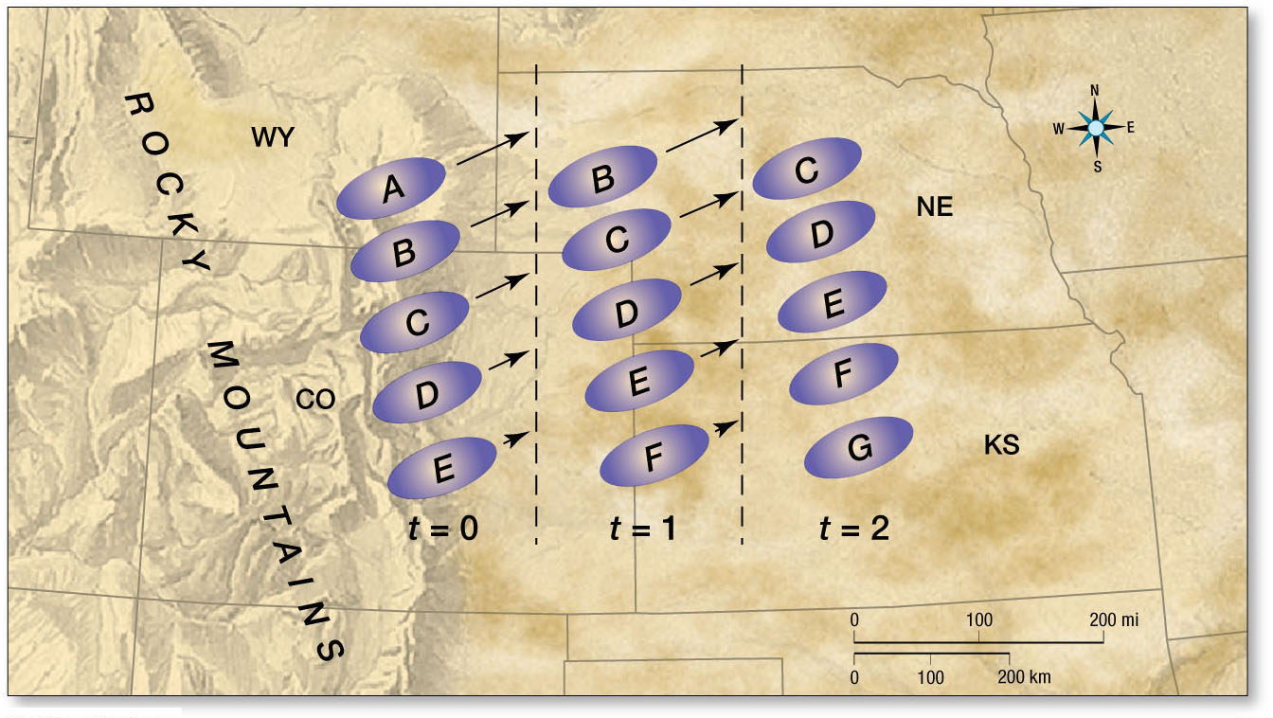
Thunderstorms: Air Mass, Multicell, and Supercell
Multicell and Supercell Storms
Surface wind flow

Slide 22
Thunderstorms: Air Mass, Multicell, and Supercell
Multicell and Supercell Storms
Squall line thunderstorms are arranged in a linear band.
Precipitation exists in the central and western areas of the squall line.
They usually form in the warm section of a midlatitude cyclone.
Downdrafts reach the ground and surge forward as a wedge of cold, dense air known as a gust front.
Warm air lifts ahead to form a shelf cloud.
Beneath the gust front, along the leading edge, rotating air can produce a roll cloud.

Slide 23
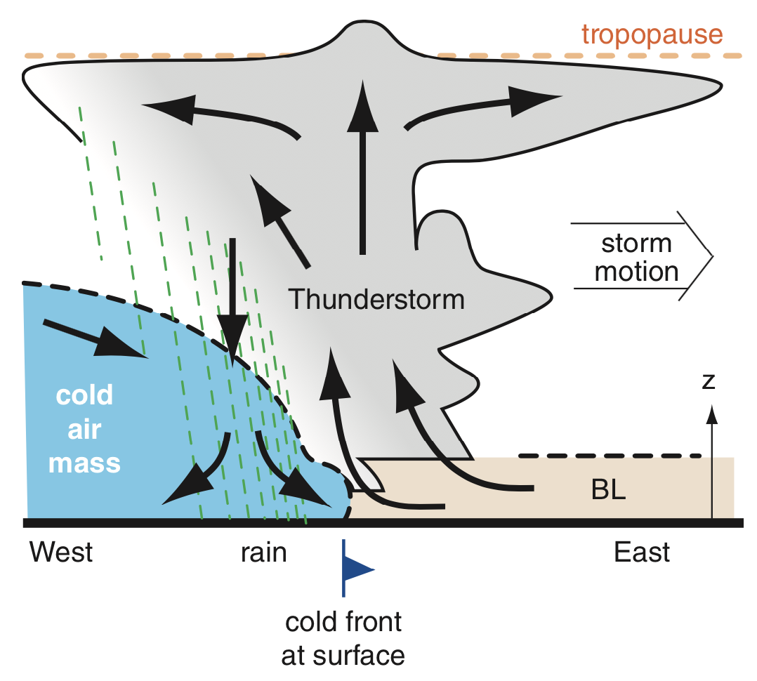
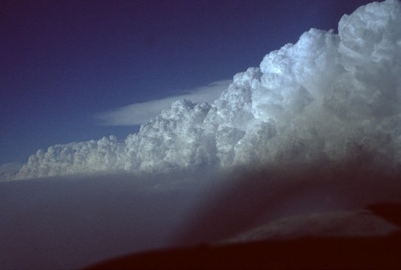
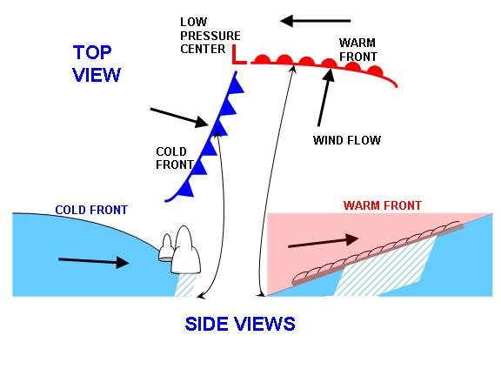
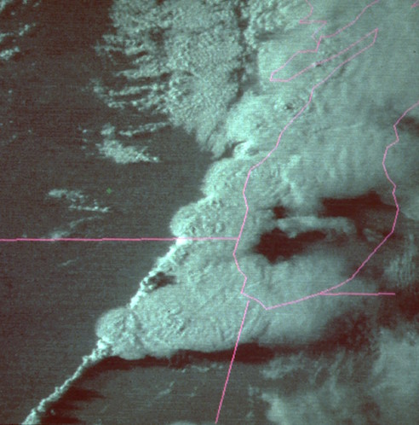
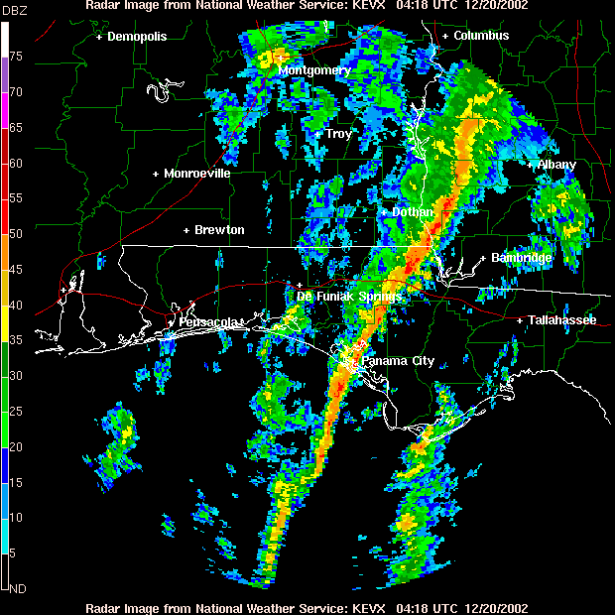
Thunderstorms: Air Mass, Multicell, and Supercell
Wind shear important!!!!

Slide 24
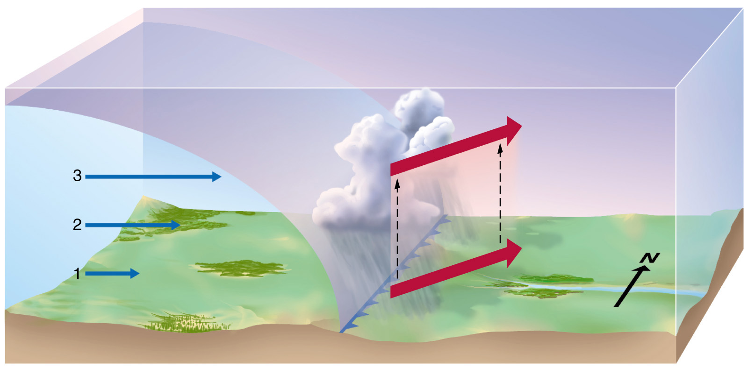
Thunderstorms: Air Mass, Multicell, and Supercell
No more increase of wind speed once friction is gone
Rapid increase of wind speed (less friction)
Wind shear
Slow wind speed close to ground (friction)
Cold front
concave

Slide 25
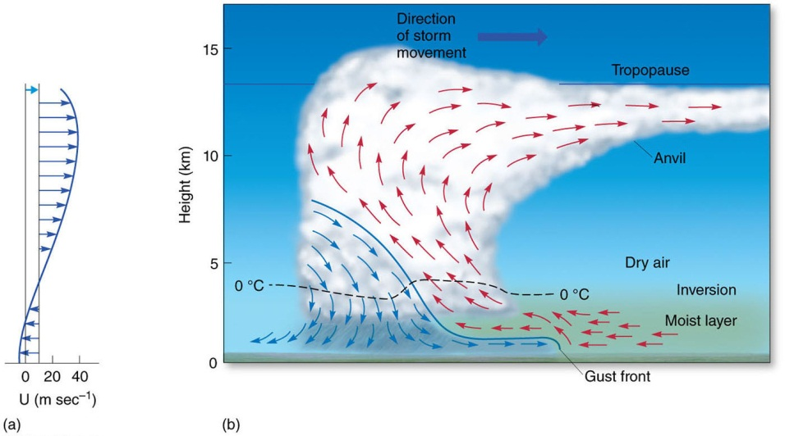
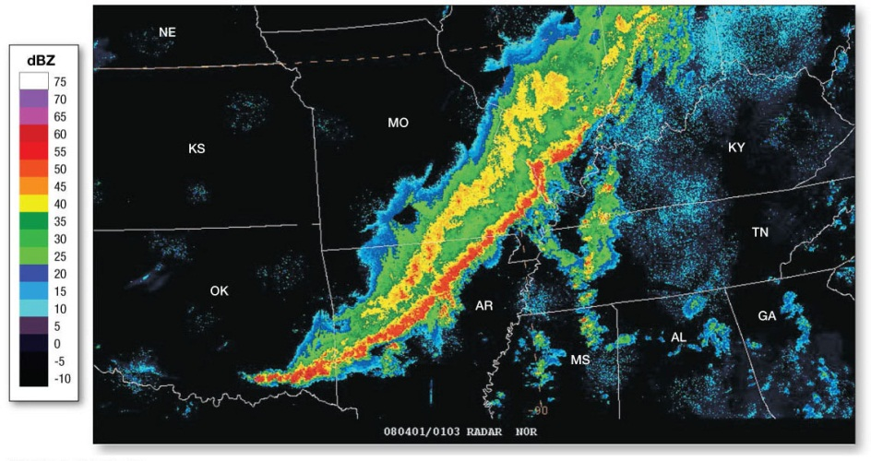
Thunderstorms: Air Mass, Multicell, and Supercell
Higher wind speeds aloft push top of cloud into the direction of the storm movement
-> causes updraft at leading edge
These are the parts in the warm, moist area: continuous re-supply of warm and moist air
Downdrafts at trailing edge. Gust front at ground toward leading edge.
-> causes further uplift of warm and moist air
-> self-sustained squall line t-storm (hours to days)

Slide 26
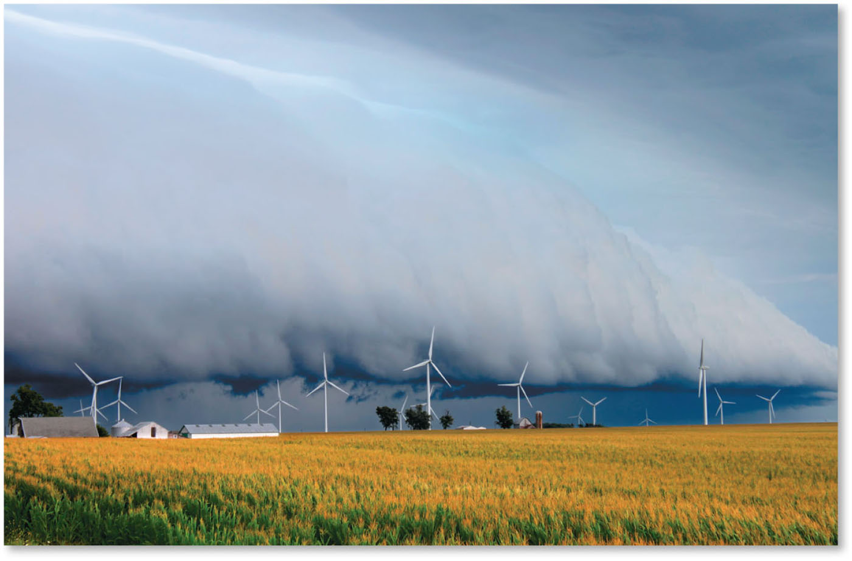
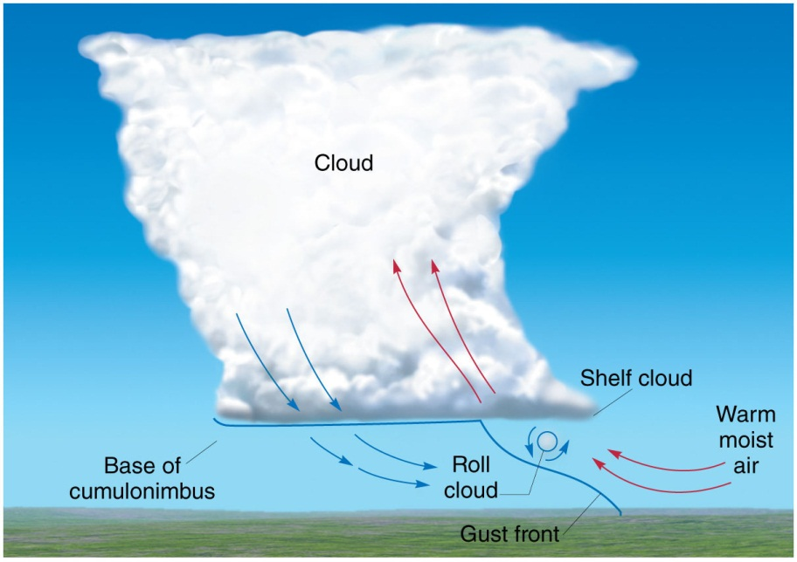
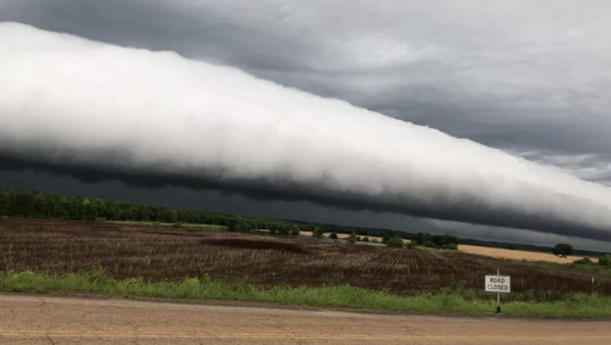
Thunderstorms: Air Mass, Multicell, and Supercell
Shelf cloud
Roll cloud

Slide 27
Thunderstorms: Air Mass, Multicell, and Supercell
Multicell and Supercell Storms
Supercells are more severe and intensely powerful storms that contain a single updraft zone.
Severe thunderstorms have wind speeds that exceed 93km/hr (58mph), hailstones larger than 2.4cm (1in) in diameter, or spawn tornadoes.
Wind shear, high water vapor, uplift, and instability are critical conditions for severe storm development.
A single, extremely powerful single cell thunderstorm.
Complex array of up and downdraft relationship.
Potential for tornados, supercell features are a “hook”

Slide 28
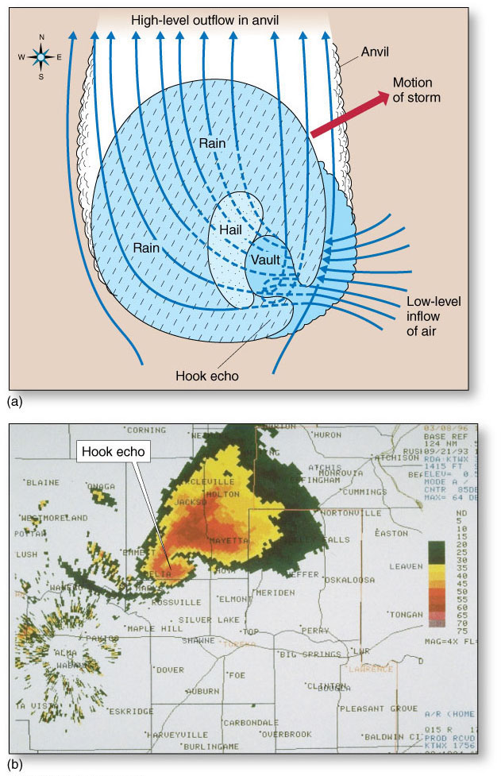
Thunderstorms: Air Mass, Multicell, and Supercell
“Hook echo”: tornado possible/likely.

Slide 29
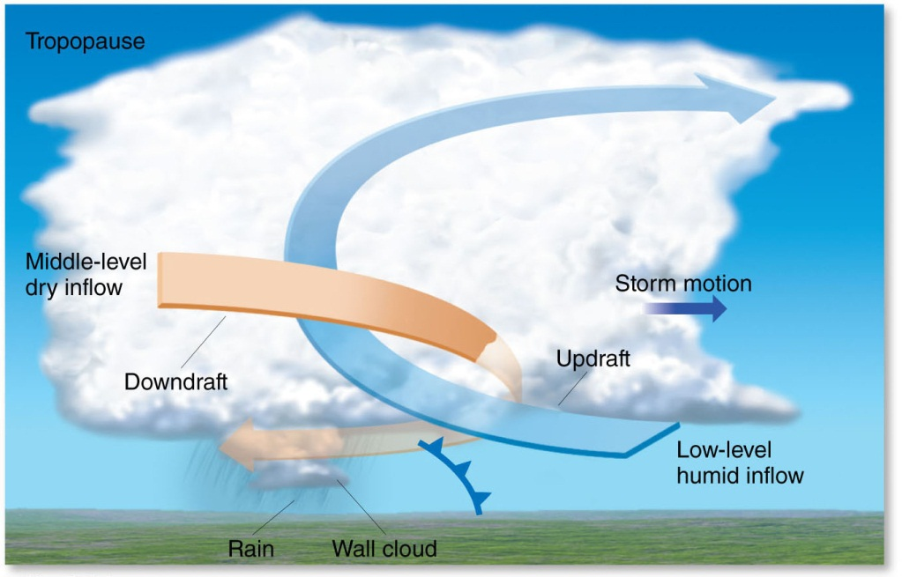
Thunderstorms: Air Mass, Multicell, and Supercell
Multicell and Supercell Storms

Slide 30
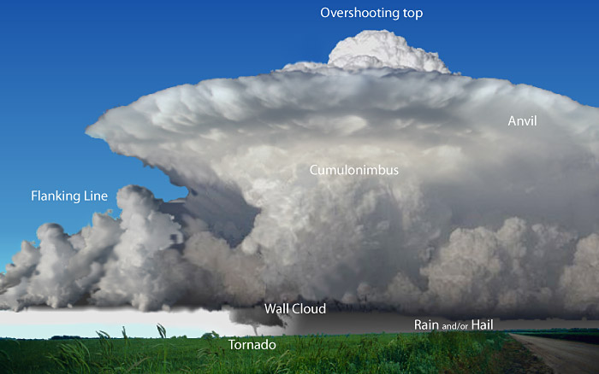
Thunderstorms: Air Mass, Multicell, and Supercell
Multicell and Supercell Storms

Slide 31
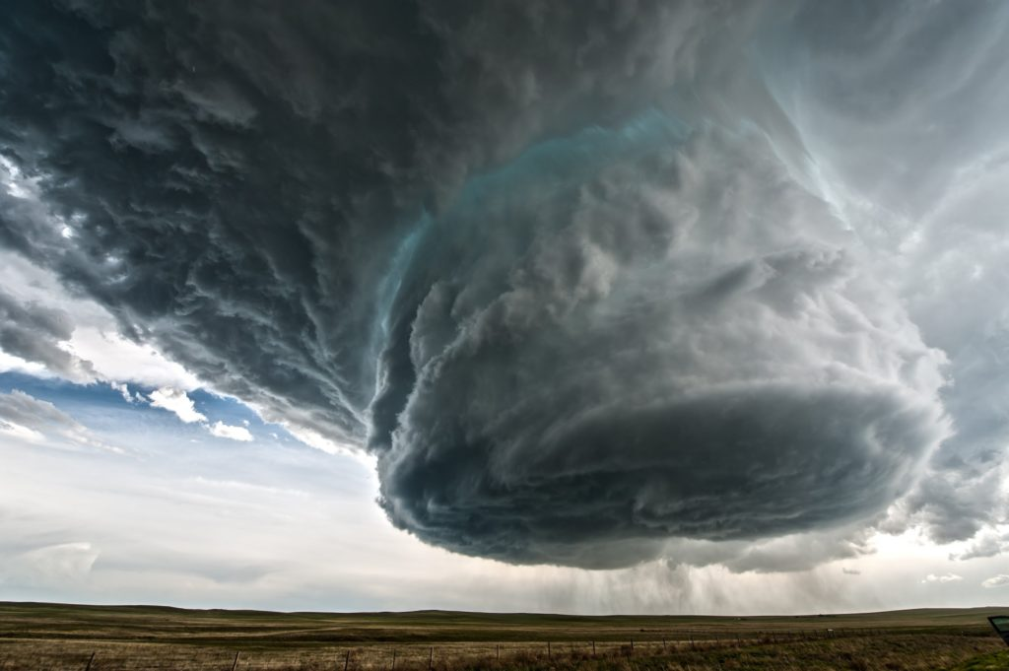
Thunderstorms: Air Mass, Multicell, and Supercell
Wall cloud

Slide 32
Attendance Quiz
Please go to Canvas and do the attendance quiz!
Needs to be completed between 9 am and 5 pm on April 16. Usual 3 min time limit.
Password: tstorm

Slide 33
Summary and Outcomes
Lightning (the principles)
Electric charge separation
Stroke development, types
Thunderstorms
Air mass and severe t-storms, multicell, squall lines – pushed by cold fronts in self-sustained way
Last HW (on Module 10) posted. Next Tuesday: tornadoes

